Slide 1
TIỀN GIANG
Address: INTERSECTION OF NGUYEN THI THAP – NGUYEN CONG BINH – LE VAN PHAM, WARD 5, MY THO CITY
Specification:
View: | > 500m
Size: | 17m(W) x 8m(H)
Square: | 136m2
Traffic: | about 70,000 people/day
Material: | iron board
Lighting system: | 11 Philip 100W LED bulbs and 4 hours/night lighting

Slide 2
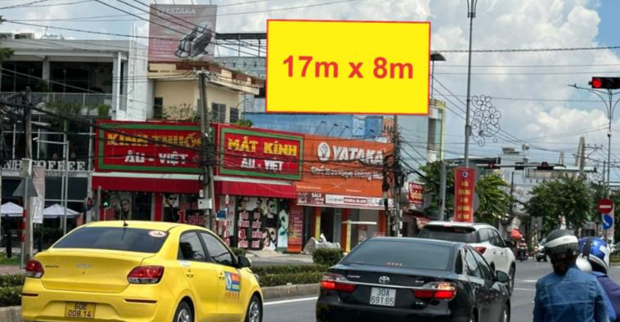
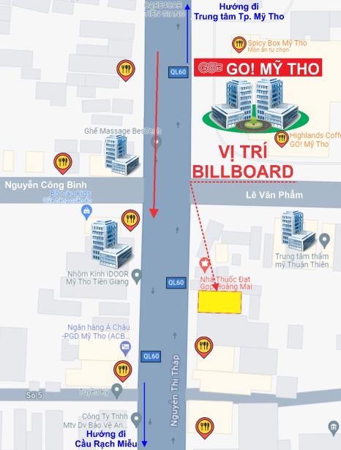
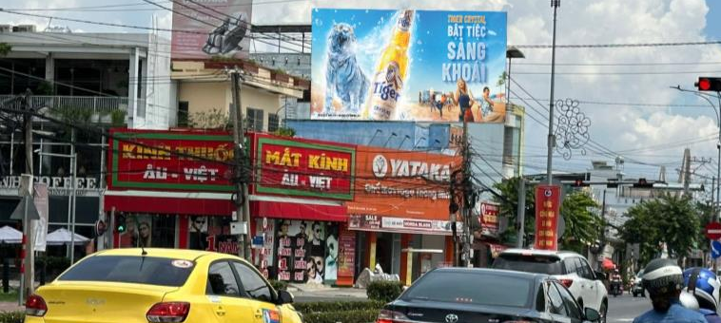

Slide 3
THANK YOU!

